Slide 1


Hierarchical Models, and Neural Simulations
Ryan Smith, Rowan Hodson, and Christopher Whyte

Slide 2
Hierarchical Models
Active Inference Tutorial

Slide 3
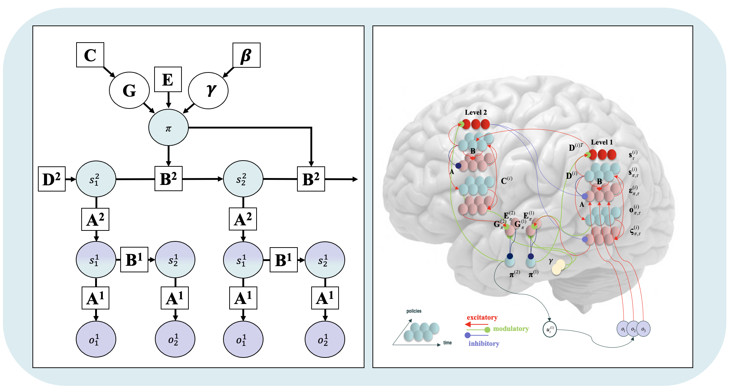
Why Go Hierarchical?

Slide 4
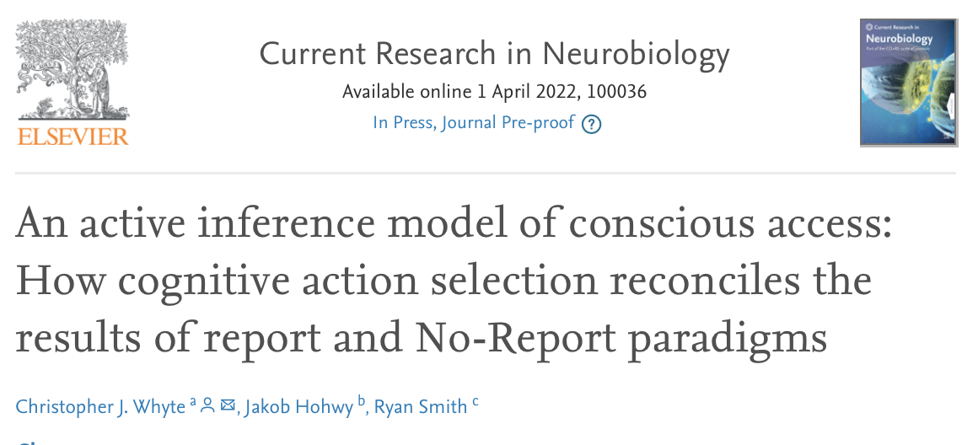
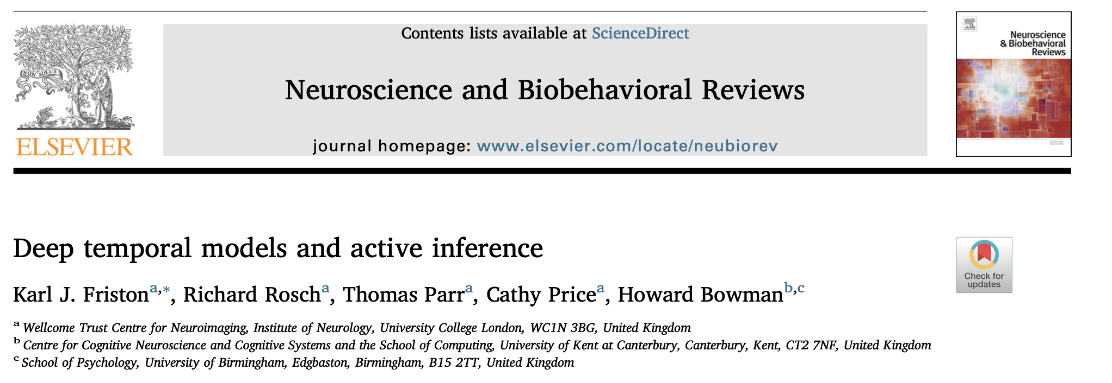

Why Go Hierarchical?
Hierarchical models allows us to model tasks with nested temporal structure.
Reading
Visual Search
Working memory
Conscious perception
Odd ball tasks
Speech/language generation

Slide 5
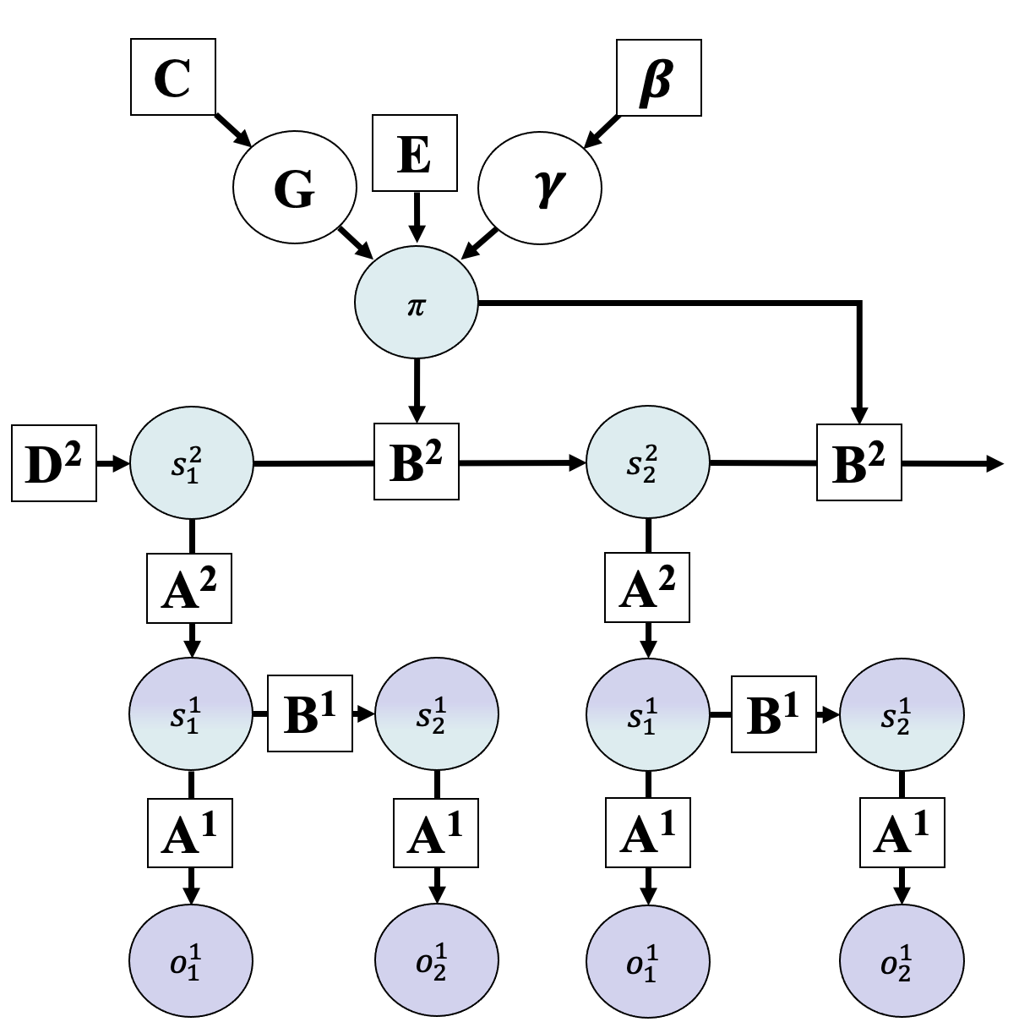
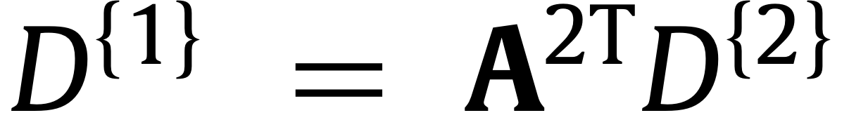
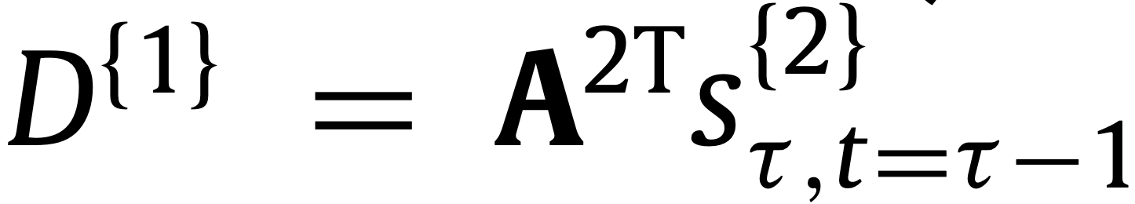
Linking Levels (Descending Messages)
Hierarchical levels provide the initial state probabilities for the level below.
t=1:
t>1:

Slide 6
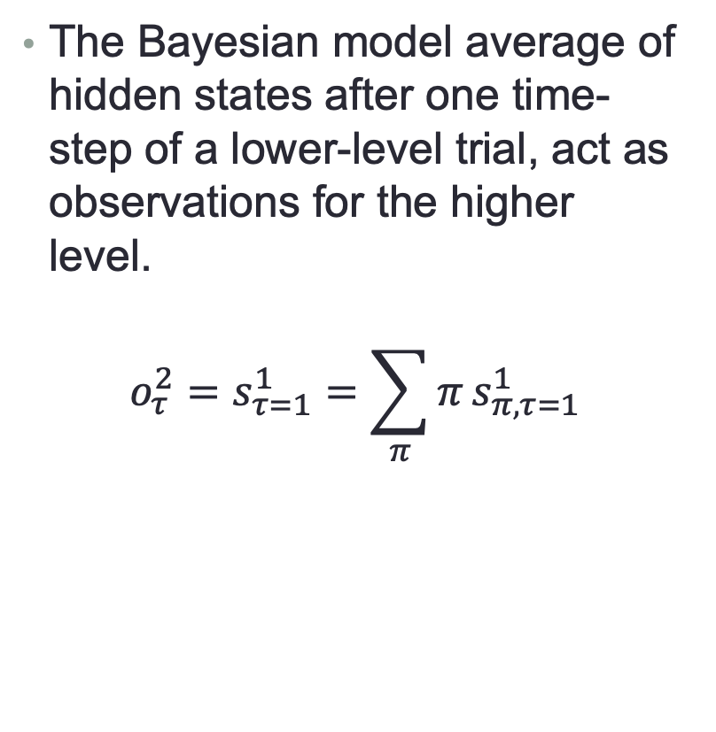
Linking Levels (Ascending Messages)
The Bayesian model average of hidden states after one time-step of a lower-level trial, act as observations for the higher level.
$$o_{τ}^{2}=s_{τ=1}^{1}=\sum_{π}{π}s_{π,τ=1}^{1}$$

Slide 7
Neural Process Theory
Active Inference Tutorial

Slide 8
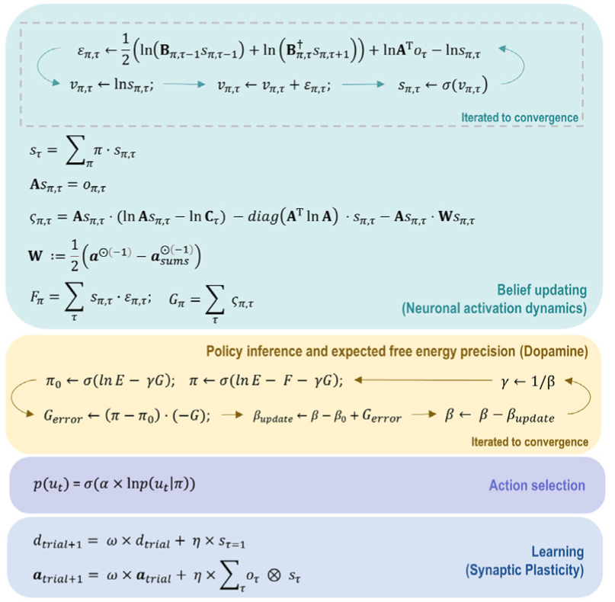
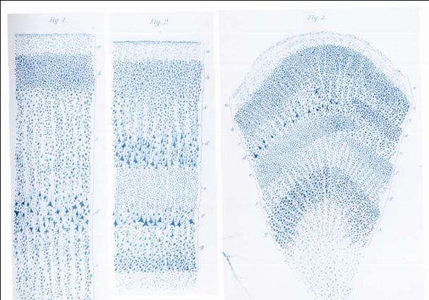
Implementation in Microcircuit
2
3
4
Supragranular layer
granular layer
Infragranular layer
5
Belief updating
1
Action selection
Learning
Model reduction
policies
excitatory
modulatory
Precision
time
inhibitory

Slide 9
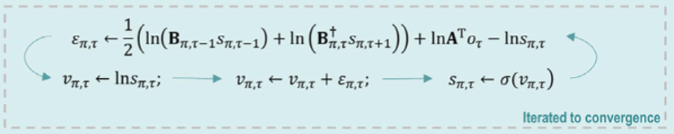
Implementation in Microcircuit
2
3
4
Supragranular layer
granular layer
Infragranular layer
5
Belief updating
1
Action selection
Learning
Model reduction
policies
excitatory
modulatory
Precision
time
inhibitory

Slide 10
Implementation in Microcircuit
2
3
4
Supragranular layer
granular layer
Infragranular layer
5
1
1
Belief updating
1
Action selection
Learning
Model reduction
policies
excitatory
modulatory
Precision
time
inhibitory

Slide 11
Implementation in Microcircuit
2
3
4
Supragranular layer
granular layer
Infragranular layer
5
1
1
2
2
Belief updating
1
Action selection
Learning
Model reduction
policies
excitatory
modulatory
Precision
time
inhibitory

Slide 12
Implementation in Microcircuit
2
3
4
Supragranular layer
granular layer
Infragranular layer
5
1
1
2
3
2
Belief updating
1
Action selection
Learning
3
Model reduction
policies
excitatory
modulatory
Precision
time
inhibitory

Slide 13
Implementation in Microcircuit
2
3
4
Supragranular layer
granular layer
Infragranular layer
5
4
1
1
2
3
4
2
Belief updating
1
Action selection
Learning
3
Model reduction
policies
excitatory
modulatory
Precision
time
inhibitory

Slide 14
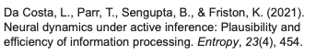
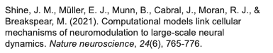
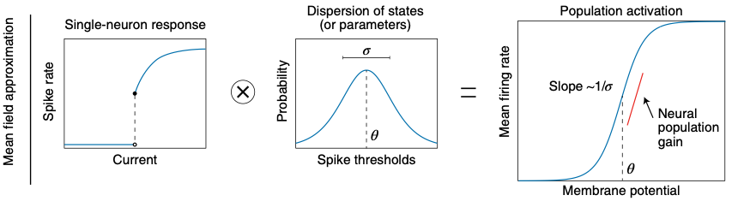
Firing Rates and ERPs
In mean-field models of brain function the mean firing rate of a population is a sigmoid function of the mean membrane potential.

Slide 15
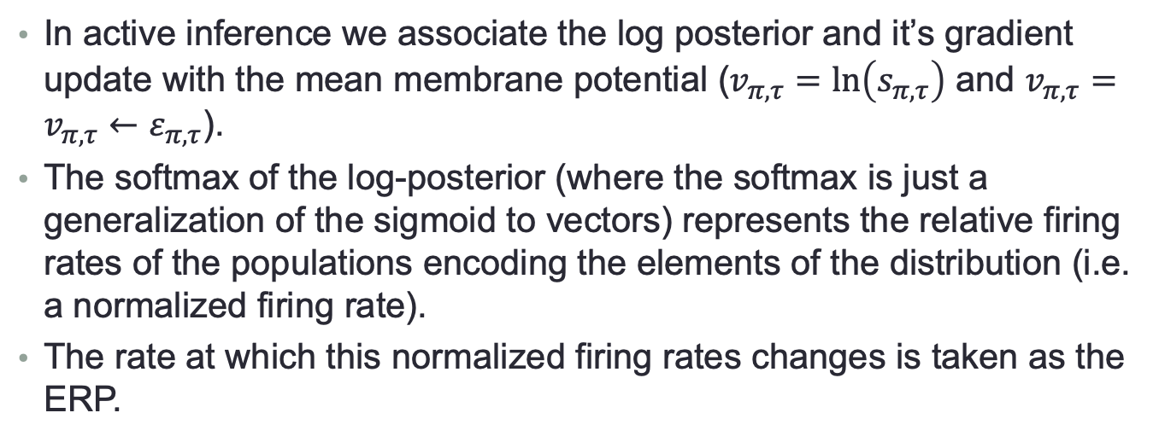
Firing Rates and ERPs
In active inference we associate the log posterior and it’s gradient update with the mean membrane potential ($v_{π,τ}=ln\left(s_{π,τ}\right)$ and $v_{π,τ}=v_{π,τ}←ε_{π,τ}$).
The softmax of the log-posterior (where the softmax is just a generalization of the sigmoid to vectors) represents the relative firing rates of the populations encoding the elements of the distribution (i.e. a normalized firing rate).
The rate at which this normalized firing rates changes is taken as the ERP.

Slide 16
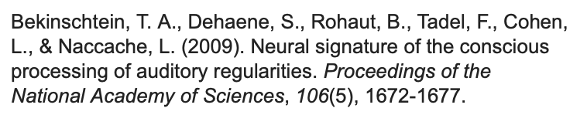
1st- and 2nd-level states

Slide 17
Early vs. late ERPs
Before learning to expect deviation
After learning to expect deviation (10 repetitions)
Tone
Tone

Slide 18
Early vs. late ERPs
Before learning to expect deviation
After learning to expect deviation (10 repetitions)
Tone
Tone

Slide 19
Early vs. late ERPs
Reproduces established mismatch negativity and P300 effects.

Slide 20
Programming exercises
Active Inference Tutorial

